Slide 1


Slide 2

NLP Chatbot Development using Dialogflow
Presented by Samer Yousaf

Slide 3
My introduction
F24PROJECT8DE28
Samer Yousaf
BC210415622
GITHUB LINK:
https://github.com/Samaryousaf669/NLP-Final-deliverables.git

Slide 4
Project Introduction
In this project, We will develop a chatbot using Google Dialogflow, an NLP-powered conversational interface.
. • Chatbots are revolutionizing customer service.
• NLP enables bots to understand human language.
• Dialogflow offers powerful tools for chatbot development.
• This project automates restaurant interactions through a chatbot

Slide 5
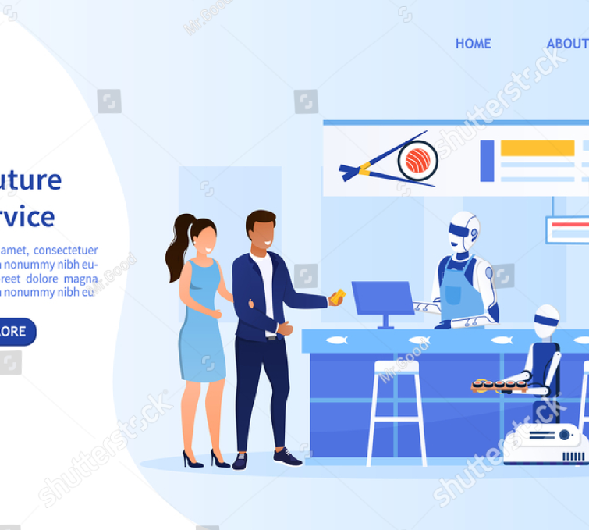
Problem Statement
• Manual customer handling leads to inefficiencies.
• Repetitive queries overload staff.
• Customers demand instant and 24/7 responses.
• Solution: Develop an intelligent chatbot using Dialogflow.

Slide 6
Implementation Overview
• Frontend form for chat interaction
• FastAPI backend processes requests
• Dialogflow handles intent recognition
• MySQL stores user queries and orders

Slide 7
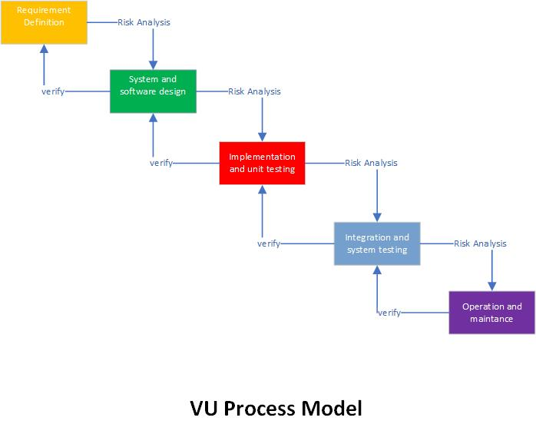
Adopted Methodology
– Carl W. Buechner

Slide 8
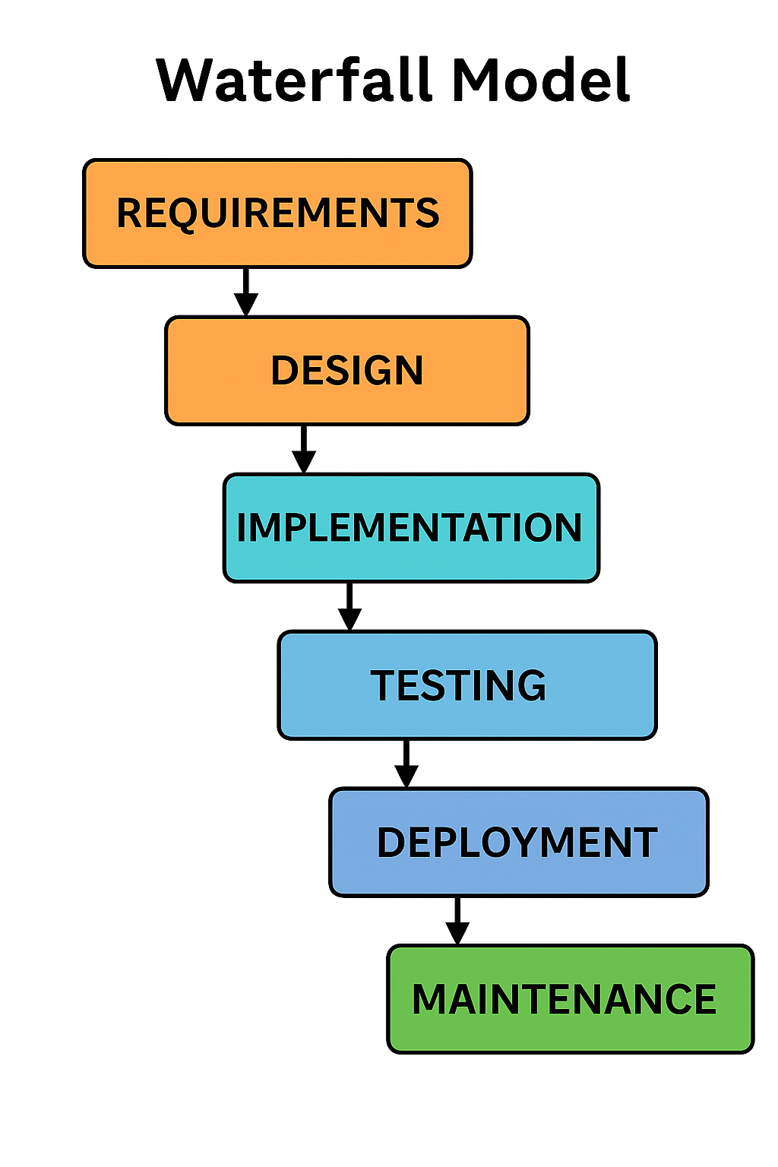
Adopted Methodology

Slide 9
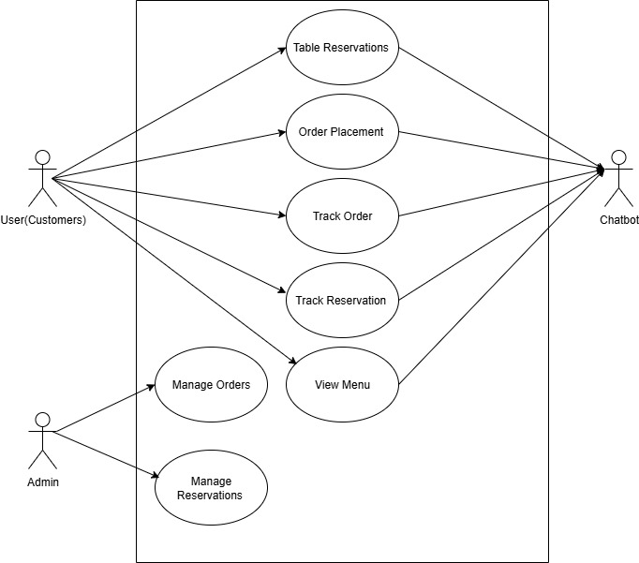
Use Case Diagram

Slide 10
Business Rules Catalog
Menu Display: Chatbot shows menu with names, descriptions, and prices.
• Order Placement: Customers can place food orders via conversation.
• Order Tracking: Users can track order status (e.g., pending, delivered).
• Order Modification: Orders can be canceled within 5 minutes if not prepared.
• User Authentication: Account creation and login are required to order.
• Admin Control: Admin can add, update, or remove menu items.
• Order Storage: All orders are saved with unique IDs and timestamps.
• Response Time: Chatbot responds within 2 seconds.
• Input Validation: User inputs are validated before processing.
• Session Management: Chat maintains continuity for multi-step orders.

Slide 11
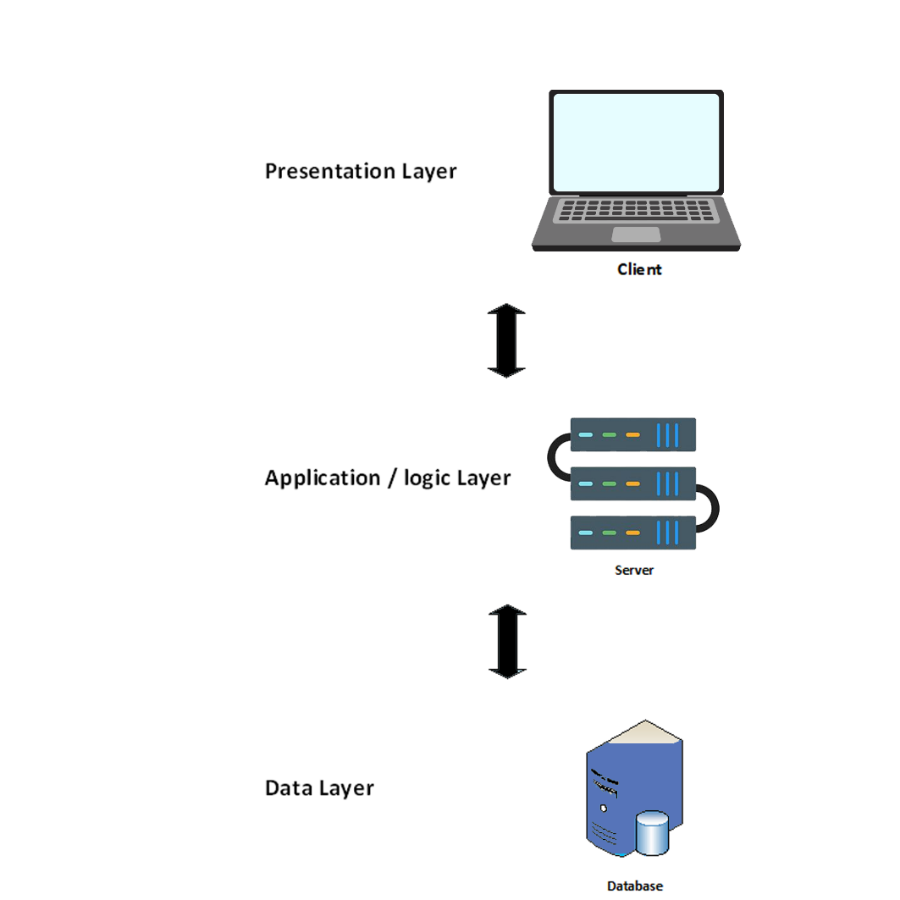
System Architecture Design

Slide 12
Business Rules Catalog
Project Manager: Oversees all activities, ensures deadlines are met, coordinates with supervisor.
Frontend Developer: Designs and builds the user interface
(HTML, CSS, JS).
Backend Developer:PHP, integrates chatbot logic, manages database ( MySQL).
Documentation Specialist: Prepares reports, SRS, presentations.
External Supervisor: Provides industry feedback, reviews work.
Project Supervisor: Guides project from academic perspective

Slide 13
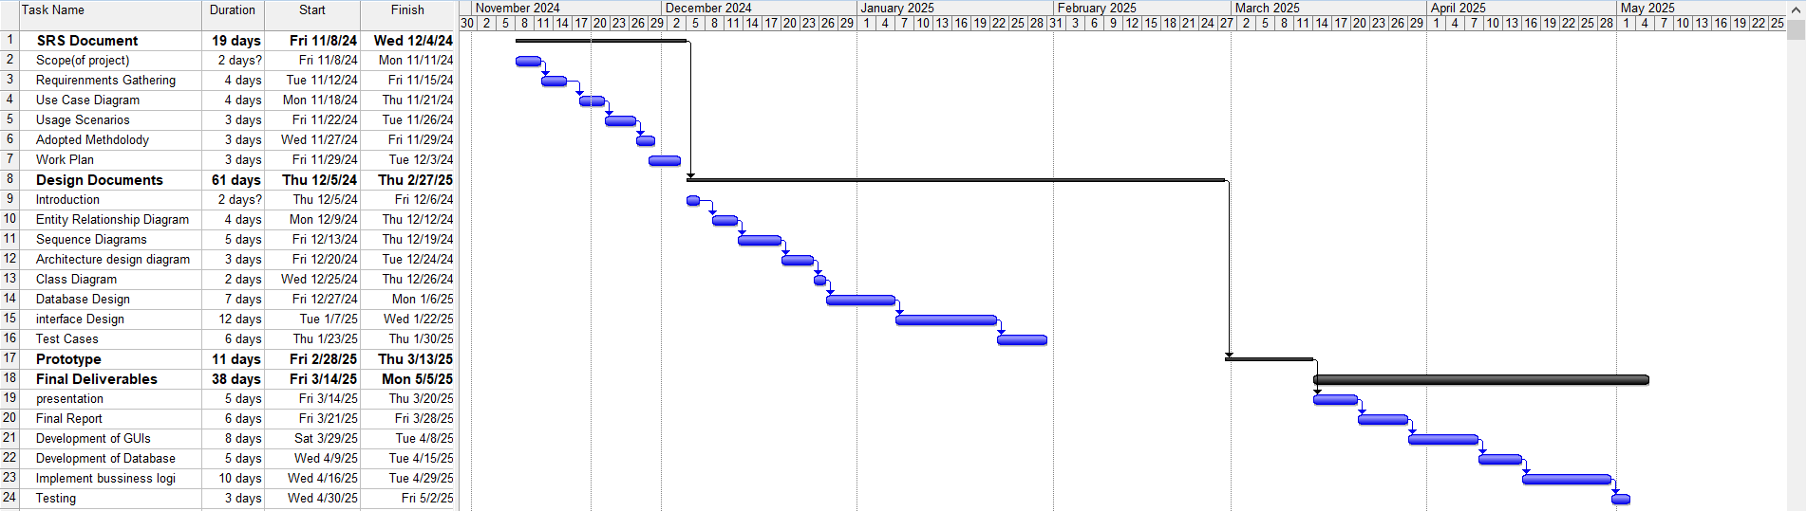
Project Schedule
of an audience’s retention rate is attributed to the visuals used

Slide 14
Sequence Diagrams
These diagrams help visualize step-by-step interactions between the user, chatbot, and system. For example, they show what happens when a customer books a table or places an order, ensuring everything flows smoothly.
here are some core sequence diagrams.

Slide 15
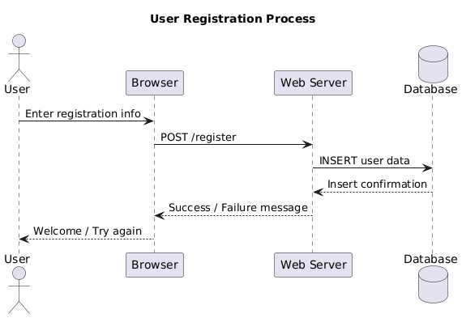
User registration SEQUENCE DIAGRAM

Slide 16
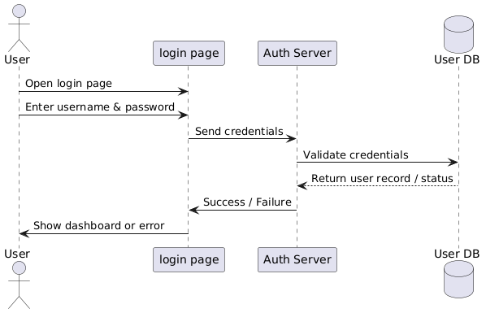
User login sequence diagram
.

Slide 17
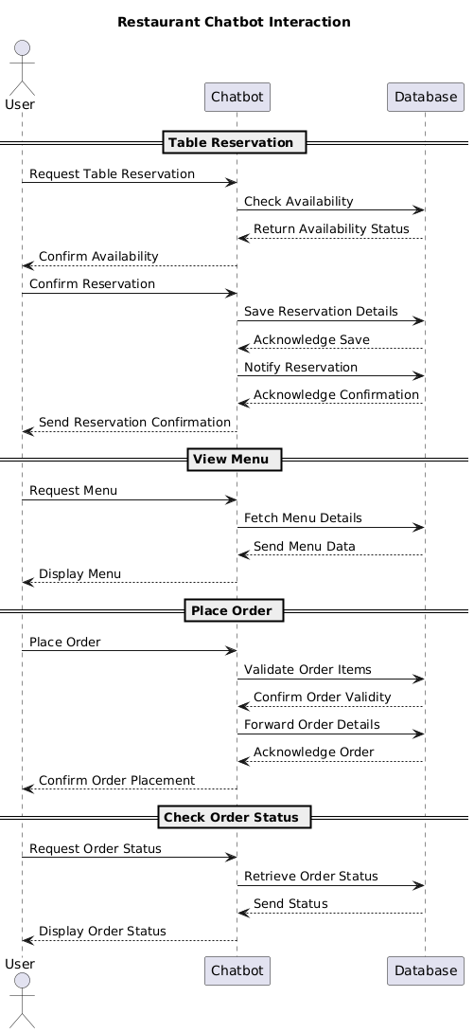
Resturant chatbot sequence diagram

Slide 18
Logical Model/ Class Diagram
This part focuses on defining different elements of the system, such as users, chatbot, orders, and reservations. It helps developers understand how different parts work together when writing code..

Slide 19
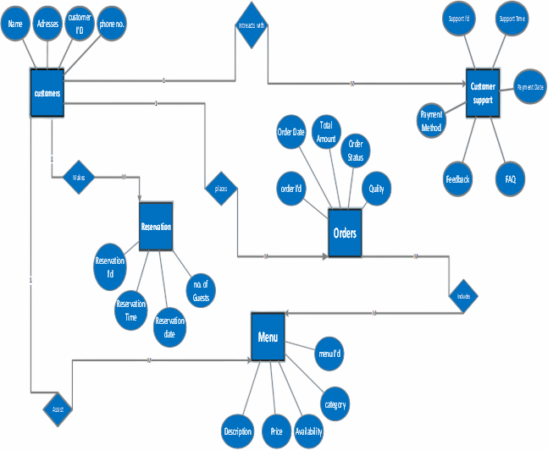
Entity Relationship Diagram (ERD)
This is like a blueprint of how different parts of the system are connected. It shows things like customers, reservations, and orders, along with how they relate to each other, making database design easier.

Slide 20
Database Diagram

Slide 21
User Interfaces
screen shots of GUI application.
Chatbot responding to queries and taking orders

Slide 22
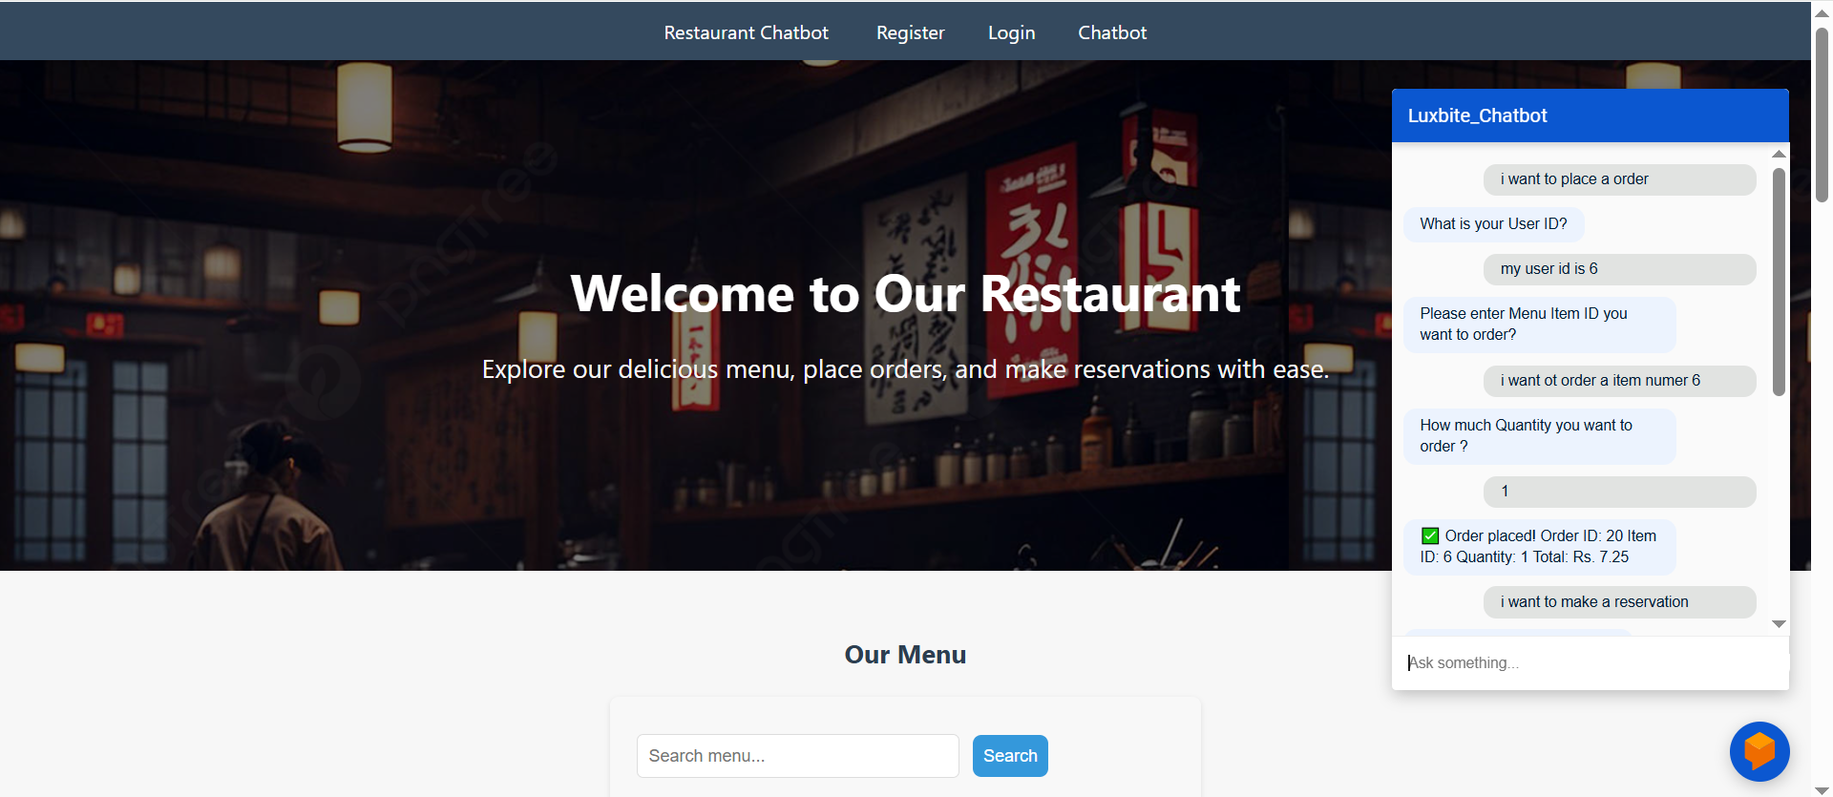
Website frontend:

Slide 23
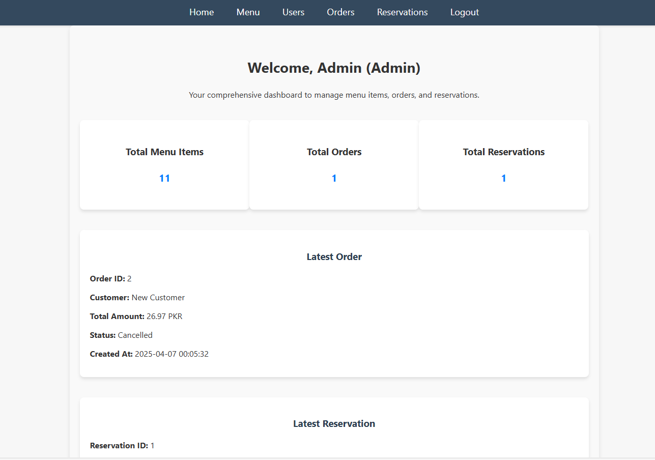
Admin Dashboard:

Slide 24
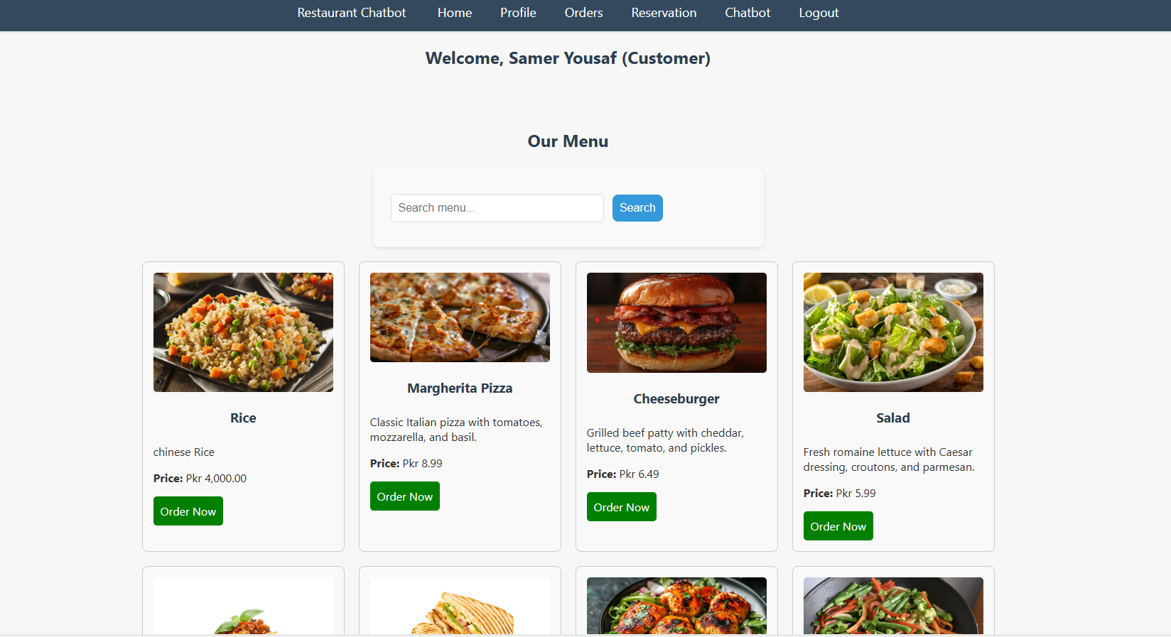
Customer Login Panel

Slide 25
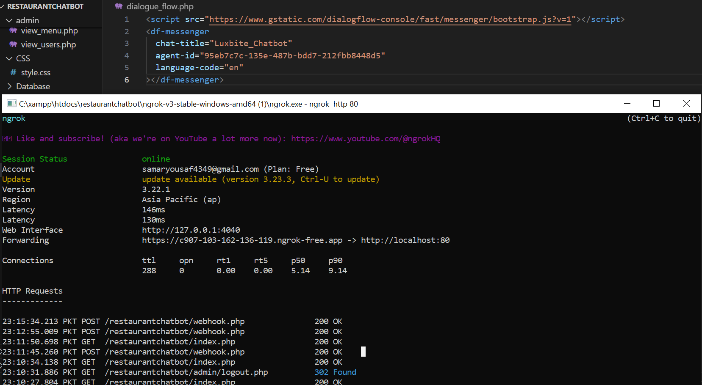
Back end:

Slide 26
Tools
.
Google Dialogflow (NLP)
HTML,CSS,JS,Bootstrap
PHP
MYSQL(database)
VS code

Slide 27
Conclusion
.
• Chatbots improve customer service efficiency.
• Dialogflow simplifies NLP-based bot development.
• Project enhances user engagement for restaurants.
• Future scope includes voice support and analytics.

Slide 28
THANK YOU samer yousaf bc210415622 bc210415622syo@gamil.com virtual university

